Slide 1
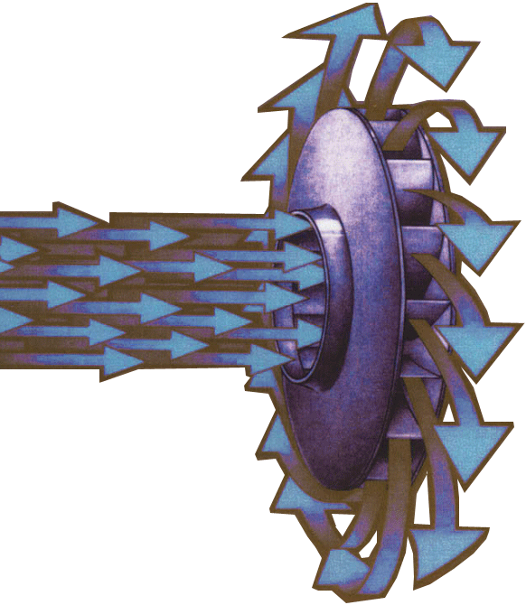

ME 410
Centrifugal Pump and Blower Design
Course Info:
Machinery,
design of radial-type pumps stage,
Other pump impeller types,
Pump details and materials,
Pump applications and selection,
Design of radial-type blower stage.
Construction details of blowers,
Blower applications.
University of Gaziantep ME 410: Centrifugal Pump and Blower Design
Mechanical Engineering Department Assist. Prof. Dr. Fuat yIlmaz

Slide 2
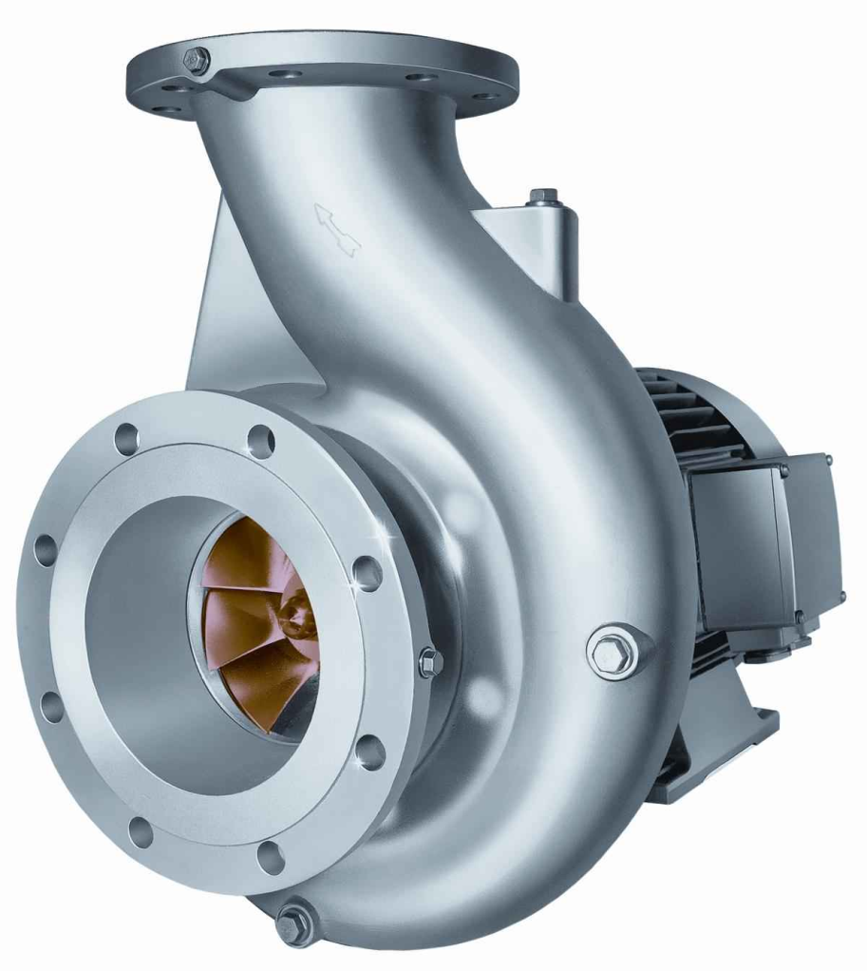
Importance and Usage Area of Pumps
Pumping systems account for nearly 20% of the world’s electrical energy demand and range from 25-50% of the energy usage in certain industrial plant operations.
Pumps and fans find application in everyday life and in a wide range of industry. They provide domestic services, commercial and agricultural services, municipal water/wastewater services, ventilating, air conditioning, process plants, textile industry, mining, refrigeration plants, driers, and industrial services for food processing, chemical, petrochemical, pharmaceutical, and mechanical industries.
University of Gaziantep ME 410: Centrifugal Pump and Blower Design
Mechanical Engineering Department Assist. Prof. Dr. Fuat yIlmaz

Slide 3
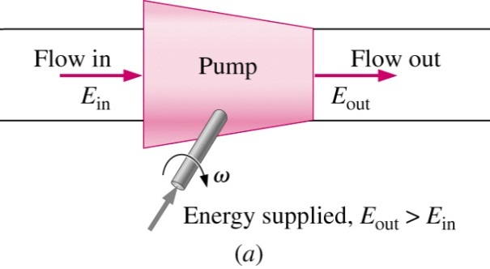
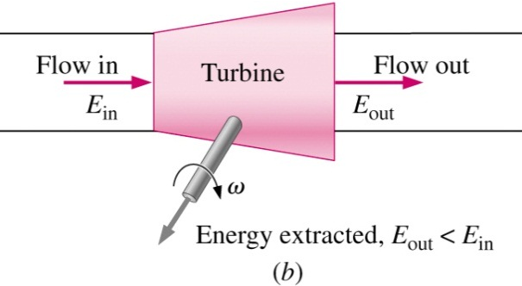
Introduction
Fluid Machinery : Transfer of the Energy
Energy is transferred between mechanical and hydraulic forms.
If a machinery is used transfer mechanical energy into hydraulic energy, they are named as pumps, fans, compressors, etc. (Fluid machinery producing head or pressure)
The additional energy can be used to increase
Velocity (flow rate)
Pressure (head)
Elevation
If a machinery is used transfer hydraulic energy into mechanical energy, they are generally named as turbines, motors, etc. (Fluid machinery producing power)
Pump: adds energy to a fluid, resulting in an increase in pressure across the pump.
Turbine: extracts energy from the fluid, resulting in a decrease in pressure across the turbine.
University of Gaziantep ME 410: Centrifugal Pump and Blower Design
Mechanical Engineering Department Assist. Prof. Dr. Fuat yIlmaz

Slide 4
Classification of Pumps According to Operating Principle
Pumps
Positive Displacement Pumps
Kinetic Pumps
Rotary Type
Reciprocating Type
Centrifugal Pumps
Special Effects
Piston
Single Rotor
Vane
Piston
Flexible Member
Screw
Peristaltic
Plunger
Radial Flow
Jet (Eductor)
Axial Flow
Hydraulic Ram
Mixed Flow
Electromagnetic
Multiple Rotor
Gear
Lobe
Circumferential
Piston
Screw
Gas Lift
University of Gaziantep ME 410: Centrifugal Pump and Blower Design
Mechanical Engineering Department Assist. Prof. Dr. Fuat yIlmaz

Slide 5
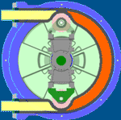
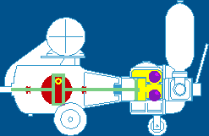
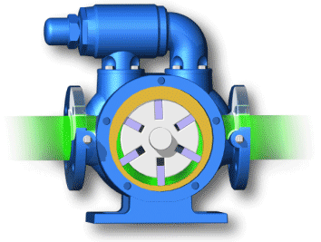
Positive Displacement Pumps
Peristaltic
Piston
Vane Pump
Displacement is the amount of liquid transferred from a pump’s inlet to its outlet in one revolution or cycle. In a rotary pump, displacement is expressed in cubic meters per revolution and in a reciprocating pump in cubic inches per cycle. If a pump has more than one pumping chamber, its displacement is equal to the displacement of one chamber multiplied by the number of chambers. Displacement is either fixed or variable.
Displacement pumps are essentially divided into reciprocating and rotary types, depending on the nature of movement of the pressure-producing members.
Each of these major classifications may be further subdivided into several specific types of commercial importance.
University of Gaziantep ME 410: Centrifugal Pump and Blower Design
Mechanical Engineering Department Assist. Prof. Dr. Fuat yIlmaz

Slide 6
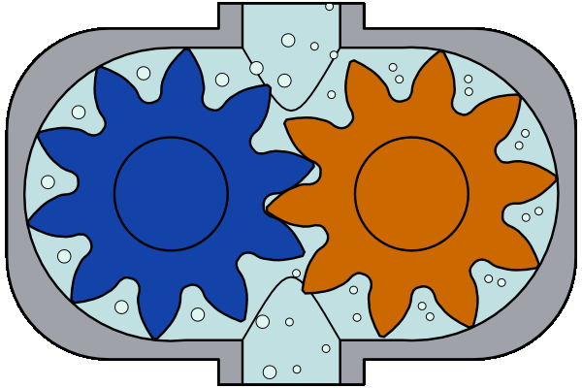
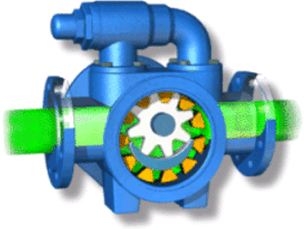
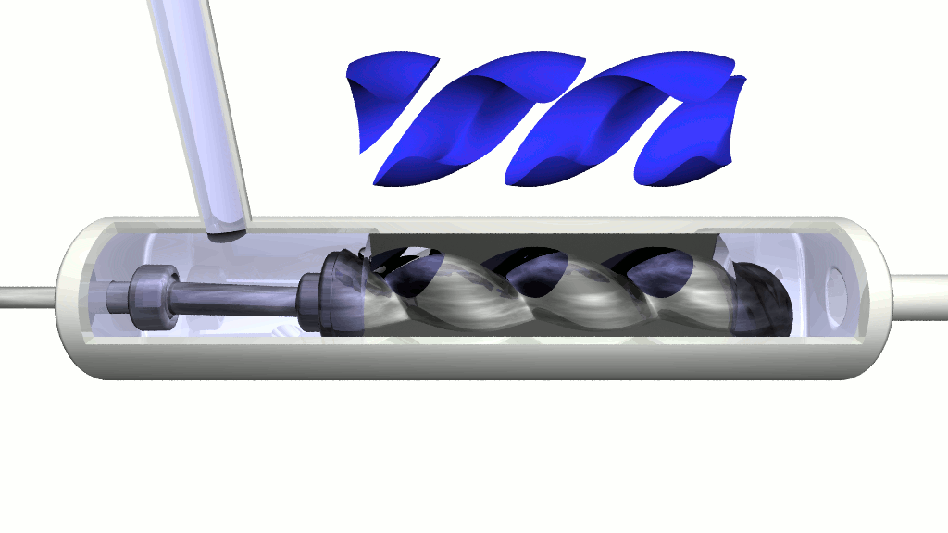
Positive Displacement Pumps
External Gear Pump
Single Screw Type
Internal Gear Pump
Positive displacement uses the reciprocating action of one or several pistons, or a squeezing action of meshing gears, lobes, or other moving bodies, to displace the media from one area into another (i.e., moving the material from suction to discharge). Sometimes the terms ‘inlet’ (for suction) and ‘exit’ or ‘outlet’ (for discharge) are used.
To move fluids positive displacement pumps admit a fixed volume of liquid from the inlet into a chamber and eject it into the discharge.
Positive displacement pumps are used when higher head increases are required. Generally they do not increase velocity.
University of Gaziantep ME 410: Centrifugal Pump and Blower Design
Mechanical Engineering Department Assist. Prof. Dr. Fuat yIlmaz

Slide 7
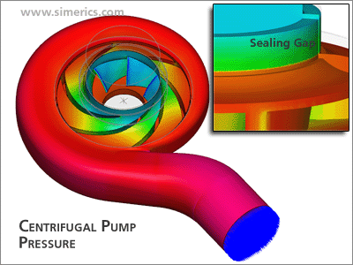
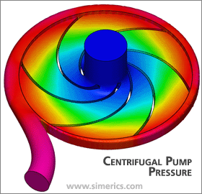
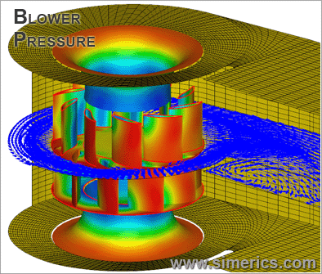
Kinetic or Dynamic Pumps
Dynamic pumps may be further subdivided into several varieties of centrifugal and special-effect pumps.
In kinetic displacement, a centrifugal force of the rotating element, called an impeller, “impels” kinetic energy to the ﬂuid, moving the ﬂuid from pump suction to the discharge or a special effect is applied.
A centrifugal pump or blower consist of one or more impellers equipped with vanes, mounted on a rotating shaft and enclosed by a casing.
A pump or a blower transfers mechanical energy from some external source to the fluid flowing through it. Thus, they increase the energy of fluid which may then be used to lift the fluid and overcome the hydraulic resistances of the delivery pipe.
University of Gaziantep ME 410: Centrifugal Pump and Blower Design
Mechanical Engineering Department Assist. Prof. Dr. Fuat yIlmaz

Slide 8
Comparison of Pump Types
 | Flow rates | Pressure | Flow characteristics
Displacement | Low | High | Pulsating
Dynamic | High | Low | Steady Flow
All positive displacement pumps have very low discharge and very high head and hence very low specific speed.
Non-positive-displacement pumps provide a smooth, continuous flow; positive displacement pumps deliver a pulsating or periodic flow with each stroke or each time a pumping chamber opens to an outlet port.
Their advantage is delivery of any liquid regardless of its viscosity.
University of Gaziantep ME 410: Centrifugal Pump and Blower Design
Mechanical Engineering Department Assist. Prof. Dr. Fuat yIlmaz

Slide 10
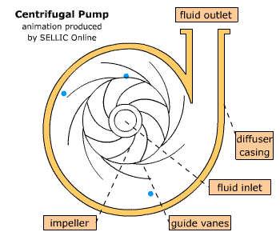
Centrifugal Pumps
A centrifugal pump is a rotodynamic pump that uses a rotating impeller to increase the pressure and flow rate of a fluid. Centrifugal pumps are the most common type of pump used to move liquids through a piping system.
The animation to the right shows a cross-sectional view. The fluid enters the pump impeller along or near to the rotating axis and is accelerated by the impeller, flowing radially outward or axially into a diffuser or volute chamber, from where it exits into the downstream piping system. The kinetic energy added by the impeller is then transformed into pressure energy as fluid flows through the ever increasing geometry of the volute.
University of Gaziantep ME 410: Centrifugal Pump and Blower Design
Mechanical Engineering Department Assist. Prof. Dr. Fuat yIlmaz

Slide 11
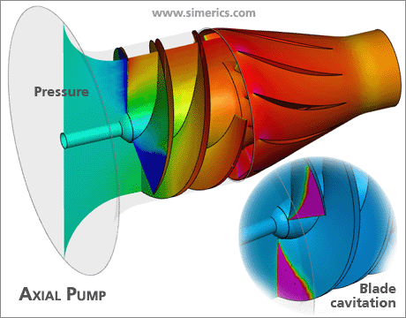
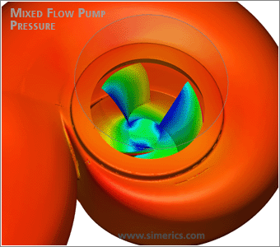
Centrifugal Pumps
Centrifugal pumps are typically used for large discharge through smaller heads.
Centrifugal pumps are most often associated with the radial flow type. However, the term "centrifugal pump" can be used to describe all impeller type rotodynamic pumps including the radial, axial and mixed flow variations.
University of Gaziantep ME 410: Centrifugal Pump and Blower Design
Mechanical Engineering Department Assist. Prof. Dr. Fuat yIlmaz

Slide 12
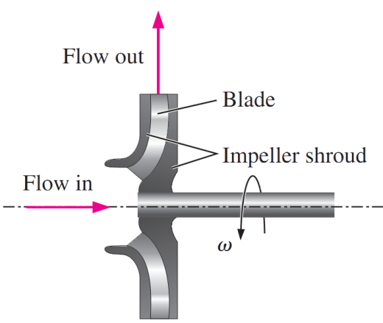
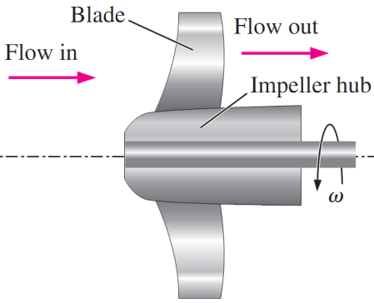
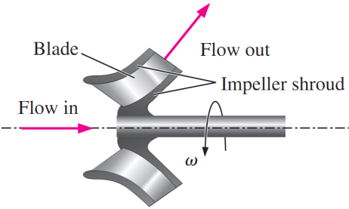
Classification of Centrifugal Pumps
This classification is based on the way by which the fluid leaves the rotating part of the pump.
  Radial-flow pumps: fluid enters axially (in the same direction as the axis of the rotating shaft), and is discharged radially (or tangentially) along the outer radius of the pump casing.
  Axial pumps: fluid enters and leaves axially.
  Mixed-flow pumps: fluid enters axially, and leaves at an angle between radially and axially.
University of Gaziantep ME 410: Centrifugal Pump and Blower Design
Mechanical Engineering Department Assist. Prof. Dr. Fuat yIlmaz

Slide 13
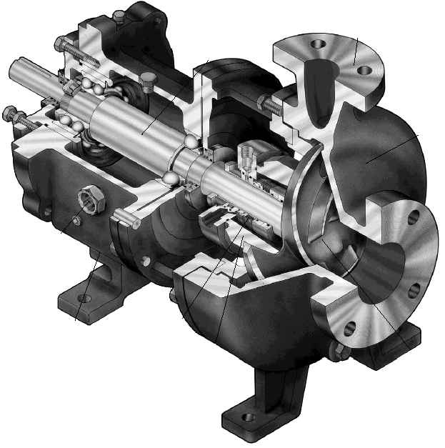
Radial Pumps
Centrifugal pumps (radial-flow pumps) are the most used pumps for hydraulic purposes.
University of Gaziantep ME 410: Centrifugal Pump and Blower Design
Mechanical Engineering Department Assist. Prof. Dr. Fuat yIlmaz

Slide 14
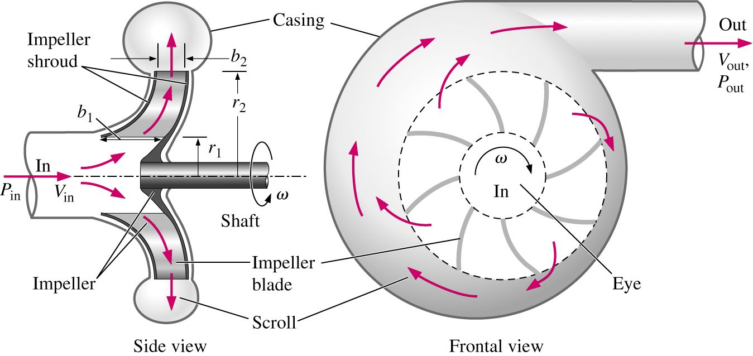
Schematic Diagram of Radial Pumps
University of Gaziantep ME 410: Centrifugal Pump and Blower Design
Mechanical Engineering Department Assist. Prof. Dr. Fuat yIlmaz

Slide 15

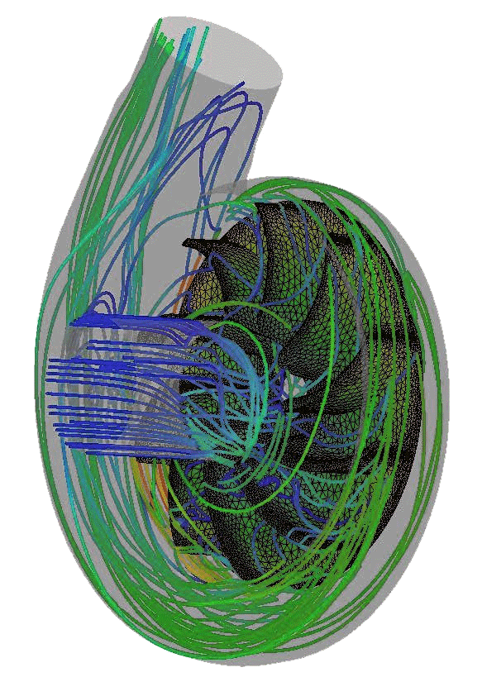
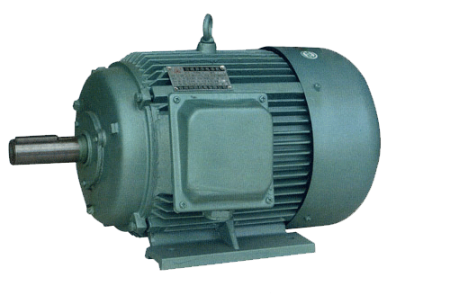

The main parts of the centrifugal pump
The two main parts of the pump are the impeller and the diffuser.
Impeller, which is the only moving (rotating) part, is attached to a shaft and driven by a motor. It consists of a series of vanes (blades). Impellers are generally made of bronze, polycarbonate, cast iron, stainless steel as well as other materials.
The casing houses the impeller and captures and directs the water off the impeller.
Casings are generally of two types: diffuser (also called as volute) and circular.
1. Volute casings are a curved funnel increasing in area to the discharge port. As the area of the cross-section increases, the volute reduces the speed of the liquid and increases the pressure of the liquid.
(Volute casings are building a higher head ).
2. Circular casing have stationary diffusion vanes surrounding the impeller periphery that convert velocity energy to pressure energy.
Conventionally, the diffusers are applied to multi-stage pumps. (circular casings are used for low head and high capacity )
Discharge / Delivery Pipe
Impeller
Electric Motor
Casing
Suction Pipe
University of Gaziantep ME 410: Centrifugal Pump and Blower Design
Mechanical Engineering Department Assist. Prof. Dr. Fuat yIlmaz

Slide 16
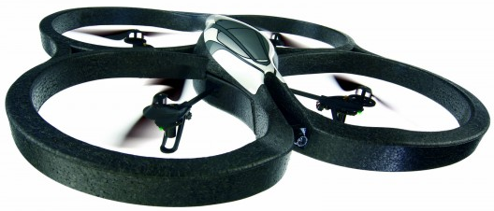
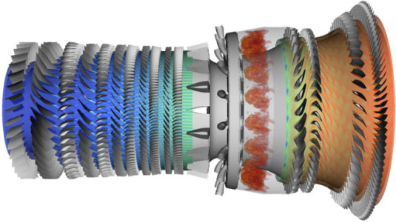

Differences between pumps, fans, and compressors
  Pumps: move liquids
  Fans: move gases with little increase in pressure
  Compressors: move gases with greater increase in pressure
Pumps and fans do not appreciably affect the density of the fluids that they move and thus incompressible flow theory is applicable.
University of Gaziantep ME 410: Centrifugal Pump and Blower Design
Mechanical Engineering Department Assist. Prof. Dr. Fuat yIlmaz

Slide 17
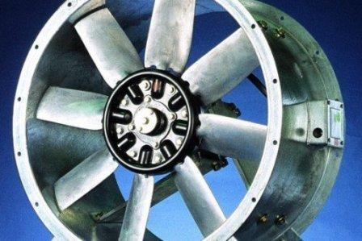
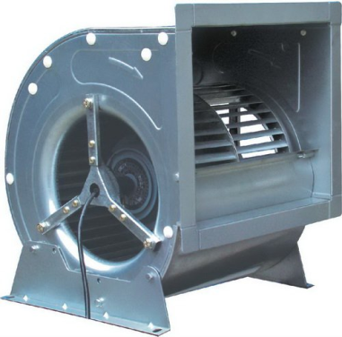
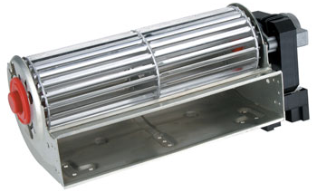
Classification of Fans
Depending on the shape of the impeller and the direction of the fluid passing through the impeller, fans are classified in three main groups;
  Axial Fans, Propeller: The axial-flow fans have blades that force air to move parallel to the shaft about which the blades rotate. This type of fan is used in a wide variety of applications, ranging from small cooling fans for electronics to the giant fans used in wind tunnels. Axial flow fans are applied for air conditioning and industrial process applications.
  Centrifugal Fans, Blower: Centrifugal fans blow air at right angles to the intake of the fan, and spin the air outwards to the outlet. They are used various industrial purposes.
  Cross Flow Fans, Tangential Fans: Centrifugal fans blow air at right angles to the intake of the fan, and spin the air outwards to the outlet. They are used extensively in the HVAC industry.
University of Gaziantep ME 410: Centrifugal Pump and Blower Design
Mechanical Engineering Department Assist. Prof. Dr. Fuat yIlmaz

